Slide 1
Intro to ML: Linear Regression
By Ayam Babu

Slide 2
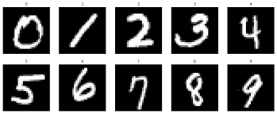
What is Machine Learning?
Ability for machine to learn and adapt without set rules
Take inputs and find trends with possible outputs
Example: Classifying handwritten digits
Model
Category
(Many)

Slide 3
Types of Machine Learning (Supervised):
Use labelled datasets
Labelled = each input’s correct output is given
Modify model based on predicted vs correct output
Model
Predicted Output
“1”

Slide 4
Types of Machine Learning (Unsupervised):
Doesn’t need a labelled dataset
Oftentimes, clustering
Model
(Lots)

Slide 5
Types of Machine Learning (Reinforcement)
Environment provides feedback and modifies model immediately
Used for gameplay AI
Input
AI makes decisions
Environment
State, Reward

Slide 6
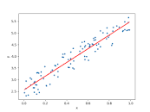
Linear Regression
Fundamental to ML
Take input of single or multiple independent variables
Find linear trend with dependent variable

Slide 7
Linear Regression (Continued):
Supervised learning algorithm
Tabular, numerical input
Numerical output (Regression)

Slide 8
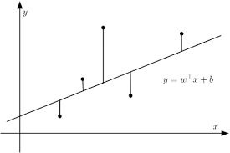
Linear Regression (Continued)
Input → Initial Model → Predicted Output
Calculate loss with Predicted Output, Actual Output
Higher loss → More change in model parameters
Loss depends on predicted, which depends on model parameters and input

Slide 9
Linear Regression in Real Life
Finance: Calculate volatility
Physics: Useful for understanding proportions (e.g. pendulum)
Business: Sales forecasting

